Slide 1
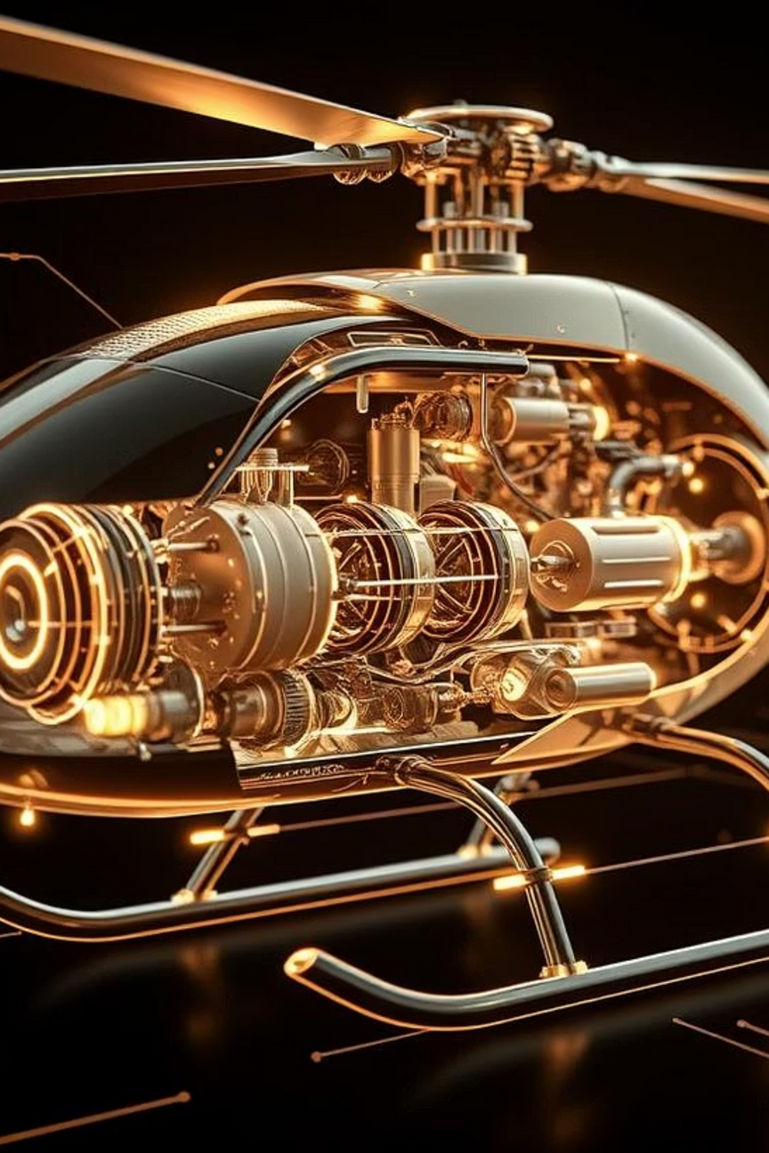


Digital Twin for Helicopter
Fuel Injection System
Team Name : RotorX
Notes:
1

Slide 2


Problem Statement
Modern helicopters require real-time monitoring and predictive maintenance for safe and efficient operation. A key subsystem is the fuel injection system, which directly impacts engine performance and fuel economy.
This project aims to develop a Digital Twin of the helicopter’s fuel injection system — a virtual, data-driven replica that simulates engine behavior, visualizes fuel flow, detects anomalies using AI, and enables “what-if” fault simulations.
The system supports continuous monitoring, early fault detection, and provides engineers with diagnostic insights through an interactive dashboard.
Notes:
1

Slide 3
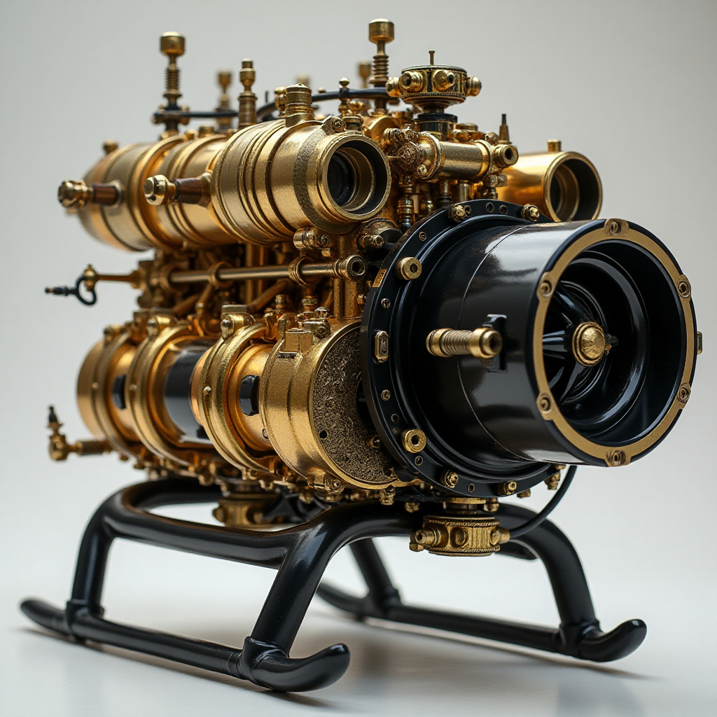
Objectives
1
Simulate Real-time Behavior
5
Simulate Faults
Simulate real-time fuel injection system behavior (RPM, flow, pressure, temp)
Simulate faults (e.g., clogging, pressure drop) and study impact
2
Stream and Visualize Telemetry
6
Provide Diagnosis
Stream telemetry via MQTT and visualize in a dashboard
Provide diagnosis with probable causes when faults occur
3
Store and Retrieve Telemetry
7
Enable Replay and Logging
Store and retrieve telemetry using a database
Enable replay, logging, and export of telemetry for analysis
4
Detect Anomalies
Detect anomalies using machine learning models
Notes:
2

Slide 4

Tech Stack
Frontend
React.ts + Vite + Tailwind CSS
Backend
FastAPI (Python)
MQTT
HiveMQ / Mosquitto
Database
MongoDB (via MongoDB Compass)
ML Models
Isolation Forest (joblib), Pandas
3D Viz
Three.js via @react-three/fiber
WebSocket
Socket.IO (optional)
Deployment
Vercel / Netlify + Render
Notes:
3

Slide 5


Datasets
The system utilizes various datasets for simulation, fault injection, and model training.
Simulated Data
Real-time telemetry via Python
Fault Data
Injected using /simulate-fault
Model Training
Data logged in MongoDB → exported to CSV for ML training
Notes:
2

Slide 6
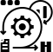
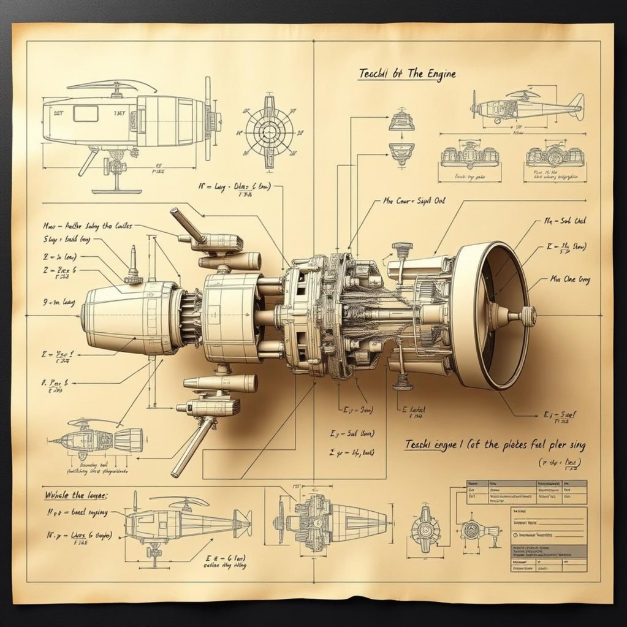
Methodology
1. System Modeling & Simulation
Build a mathematical model of the helicopter's fuel injection system.
2. Data Transmission via IoT Protocol
Transmit simulated data continuously using MQTT protocol or WebSocket.
3. Backend Data Ingestion & Storage
Use a backend framework and Store timestamped data for logging.
4. Machine Learning-based Anomaly Detection
Train an unsupervised anomaly detection model
5. Fault Injection and Diagnosis
Analyze how these faults affect engine parameters.
6. Data Visualization & Dashboard Interface
Design an interactive frontend dashboard Enable playback of past telemetry for review and analysis.
Notes:
4

Slide 7

Fuel system simulation
(RPM, Throttle, Pressure,Temp,Flow)
Fault Injection
(Injector Clog, Sensor Failure,Fuel Leak, RPM Surge, etc.)
Flowchart
SendGrid
Email alert
FastAPI Application
(REST API EndpointsCORS MiddlewareBackground Tasks)
ML Anomaly Detection
(Anomaly Score & Prediction Probable Cause Inference)
Twilio
SMS alert
MongoDB
(Telemetry Logs)
MQTT Publisher
(HiveMQ Broker)

Slide 8

Data Flow Process
1. Simulate fuel system parameters (RPM, throttle, pressure, temp, flow)
2. Optional fault injection (clog, leak, surge, sensor failure)
3. ML anomaly detection using Isolation Forest model
4. Infer probable cause if anomaly detected
5. Store telemetry data in MongoDB with anomaly flag
6. Publish clean telemetry to MQTT broker (external systems)
7. Send email alerts via SendGrid for anomalies and SMS alerts via Twilio.
8. Export anomaly data as CSV/JSON for analysis
9. Continuous monitoring and model retraining capability

Slide 9
Key Features:
1
Real-time fuel system simulation
The system includes a real-time simulation of the helicopter fuel system, providing dynamic data for monitoring and analysis.
2
MQTT telemetry streaming
Telemetry data is streamed in real-time using MQTT, ensuring low-latency data transfer.
3
MongoDB data logging
All telemetry and fault data are logged in MongoDB for historical analysis and model training.
4
REST APIs for telemetry + faults
REST APIs are provided for seamless integration and access to telemetry and fault data.
5
AI-based anomaly detection (Isolation Forest)
An AI-based anomaly detection system, utilizing Isolation Forest, identifies unusual patterns in the fuel system data.
6
React dashboard with live charts
A user-friendly React dashboard displays live charts of the fuel system parameters, providing real-time insights.
Notes:
3

Slide 10





Use Case: Aviation Maintenance Crew
The system is designed to empower Aviation Maintenance Crew with advanced tools for fuel system management.
Monitor helicopter fuel systems in real time
Provides a comprehensive overview of fuel system performance with live data.
Detect anomalies before failures occur
Proactive identification of potential issues, preventing costly downtime.
Understand root causes using AI
AI-driven insights help pinpoint the underlying reasons for anomalies.
Perform virtual fault tests to improve safety
Simulate fault scenarios to train and validate maintenance procedures without risk.
Replay and study failure scenarios from logs
Analyze past incidents to learn and improve future maintenance strategies.
Notes:
5

Slide 11
Specific Requirements
The system adheres to specific technical and performance requirements to ensure optimal operation.
Requirement
Details
Real-time data
1 second interval via MQTT
Backend inference latency
< 200 ms (simulate + predict)
MongoDB storage
Up to 1000 entries, rotated
Model compatibility
Must support joblib loading
Visuals
Live charts, optional 3D flow model
Notes:
6

Slide 12

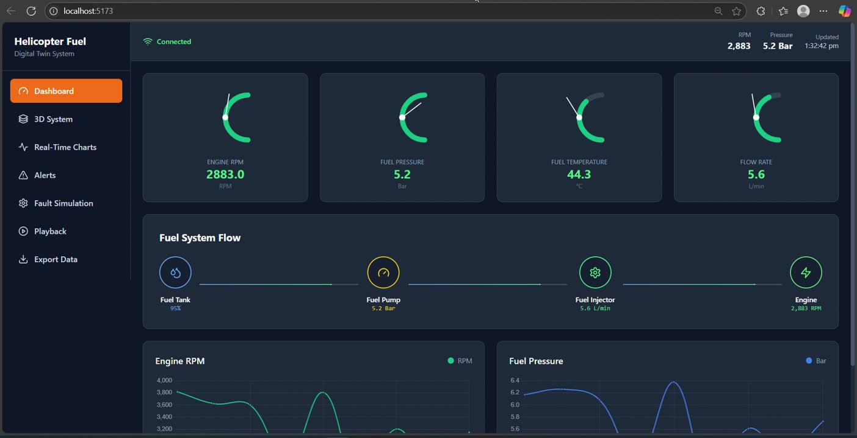
Prototype
Notes:
6

Slide 13
Thank You

